Slide 1

T
CUAI Andrew ML 스터디팀
2022.05.02
발표자 : 오규안, 고가연

Slide 2
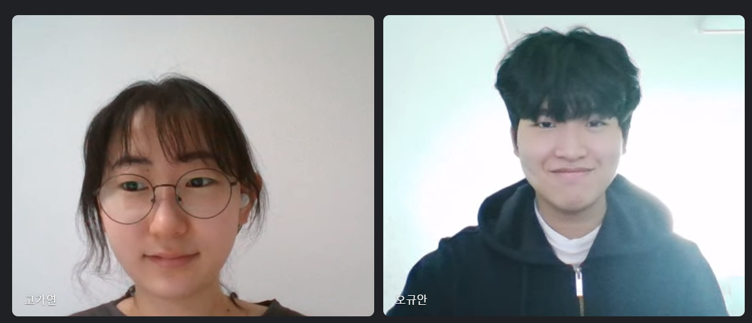
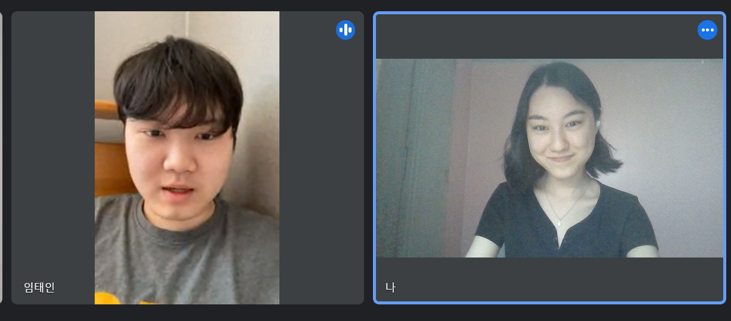
스터디원 소개 및 만남 인증
스터디원 1 : 고가연
스터디원 2 : 임태인
스터디원 3 : 김명빈
스터디원 4 : 오규안

Slide 3
목차
4주차 학습내용
- Gradient Descent
5주차 학습내용
- Multiple Linear Regression

Slide 4
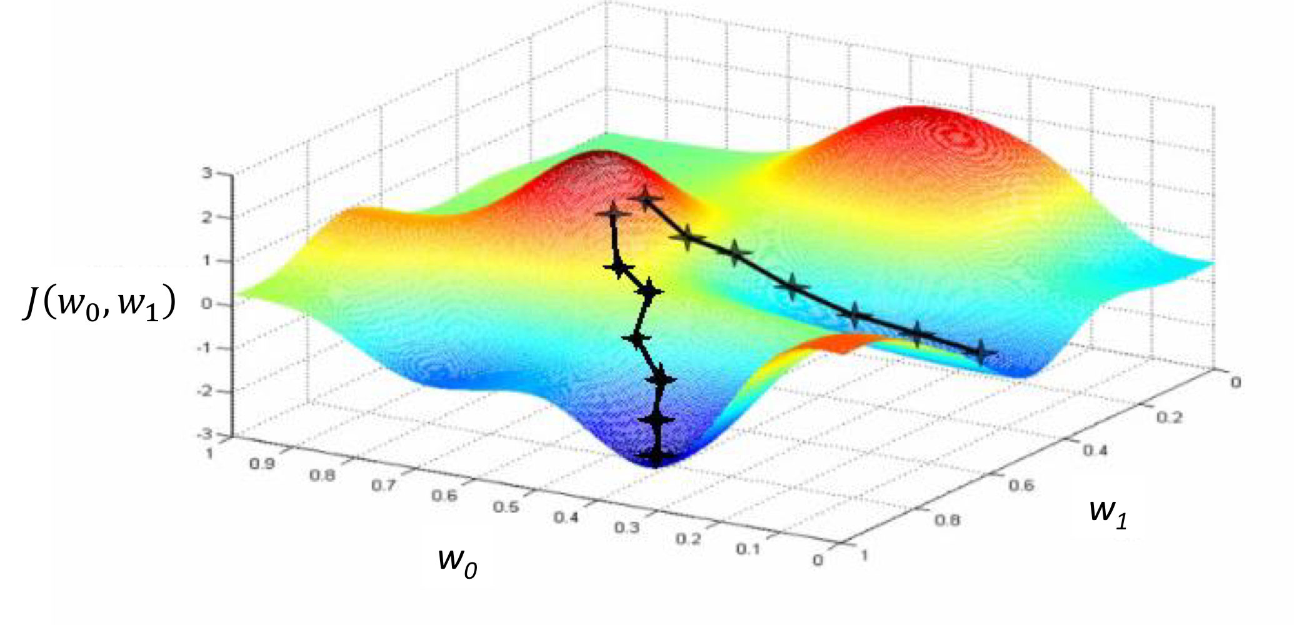
Gradient Descent / 경사 하강법
경사 하강법은 함수의 최소값을 찾는 문제에서 활용된다
함수의 한 점에서 새로운 매개변수들을 갱신하여 함수의 최소값을 찾는다.

Slide 5
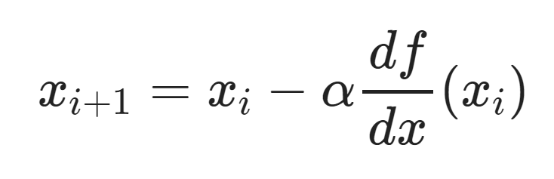
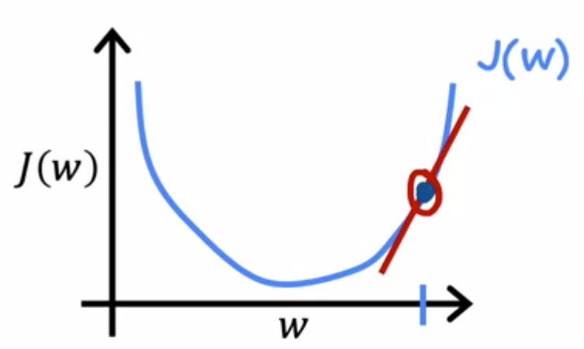
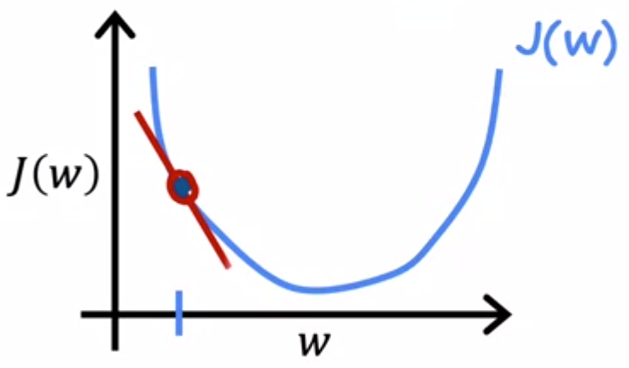
Gradient Descent Algorithm / 경사 하강법 알고리즘
> 0
< 0

Slide 6
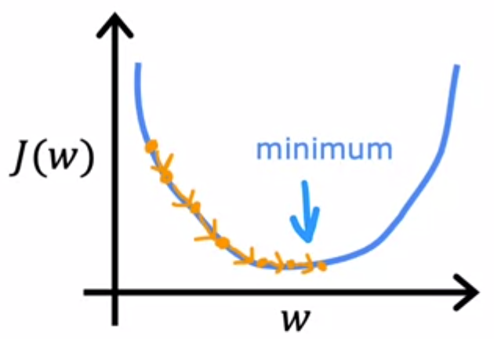
Learning Rate / 학습률
가 너무 작다면
경사 하강법의 속도가
매우 느려진다.

Slide 7
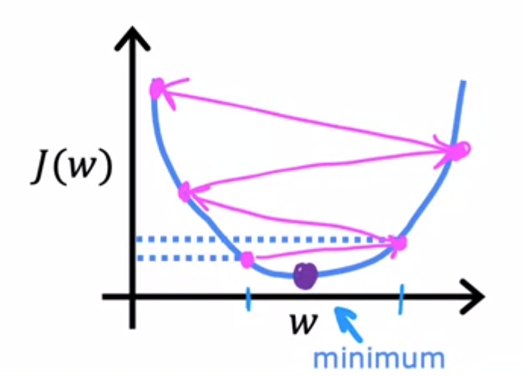
Learning Rate / 학습률
가 너무 크다면
수렴하지 못하고 발산하여
최소값을 찾지 못한다.

Slide 8
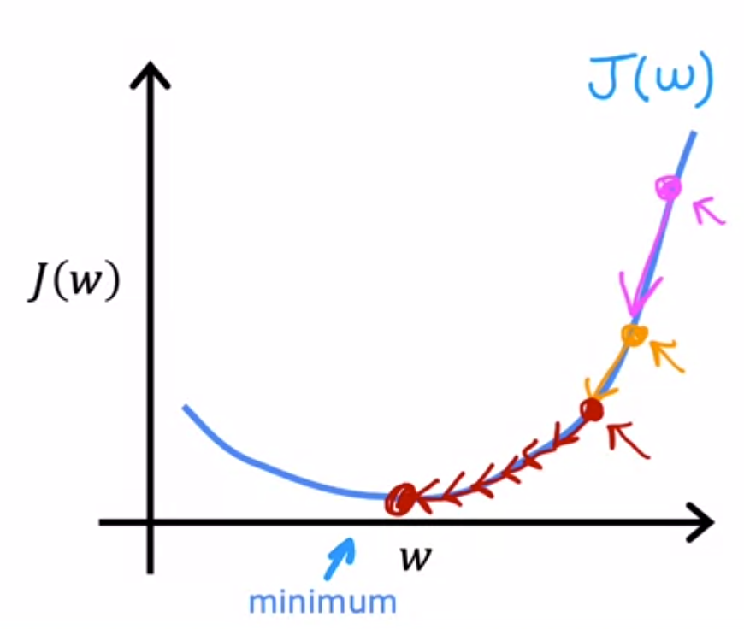
Learning Rate / 학습률
를 적절한 값으로 지정하면
느리지 않고, 적절하게 최소값을 찾을 수 있다.

Slide 9
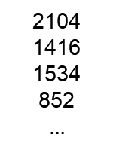

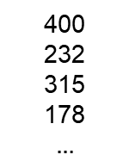
Multiple features (variables)
Size in feet squre (x)
Price ($) in 1000’s (y)
2104
1416
1534
852
$$…$$
400
232
315
178
$$…$$
One feature
$$f_{w,b}\left(x\right)=wx+b$$

Slide 10

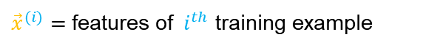
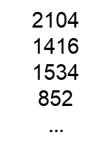
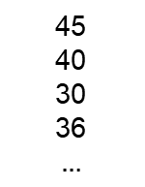
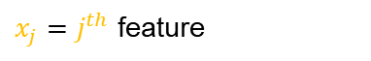
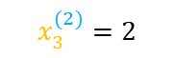



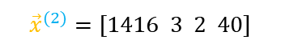

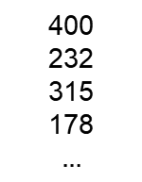

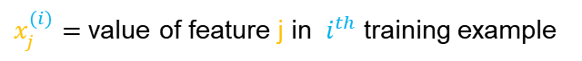
Multiple features (variables)
$$x_{1}$$
$$x_{2}$$
$$x_{3}$$
$$x_{4}$$
Size in
feet squre
Number of
rooms
Number of
floors
Age of home
In years
Price ($) in
1000’s (y)
2104
1416
1534
852
$$…$$
5
3
3
2
$$…$$
1
2
2
1
$$…$$
45
40
30
36
$$…$$
400
232
315
178
$$…$$
$x_{j}=j^{th}$ feature
n = number of features
${\vec{x}}^{(i)}=$ features of ${ i}^{th}$ training example
$${\vec{x}}^{(2)}=[1416 3 2 40]$$
$x_{j}^{(i)}=$ value of feature j in ${ i}^{th}$ training example
$$x_{3}^{(2)}=2$$

Slide 11

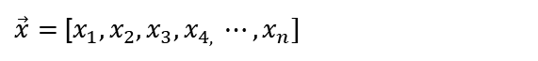
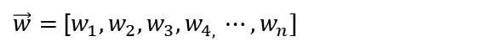

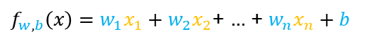
Multiple features (variables)
One feature
$$f_{w,b}\left(x\right)=wx+b$$
Multiple features
$f_{w,b}\left(x\right)=w_{1}x_{1}+w_{2}x_{2}$+ $…$ + $w_{n}x_{n}+b$
$$f_{\vec{w},b }\left(\vec{x}\right)=\vec{w}∙\vec{x}+b$$
벡터 표시 : 하나의 숫자가 아니라 여러 숫자로 구성
$\vec{w}=$ [$w_{1}, w_{2},w_{3},w_{4, }⋯,w_{n}]$
$\vec{x}=$ [$x_{1}, x_{2},x_{3},x_{4, }⋯,x_{n}]$
b = number
: Multiple linear regression

Slide 12

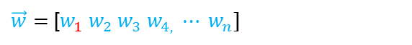
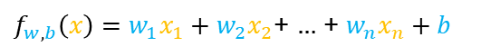
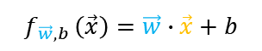
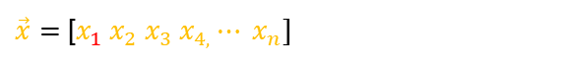
Vectorization
$\vec{w}=$ [$w_{1} w_{2} w_{3} w_{4,} ⋯ w_{n}]$
Linear algebra : count from 1
$\vec{x}=$ [$x_{1} x_{2} x_{3} x_{4,}⋯ x_{n}]$
Code : count from 0 w[0] = 1.0
w[1] = 2.5
w[2] = -3.3
Without vectorization
vectorization
dot function : mathematical dot product between vector w and vector x
$$f_{w,b}\left(x\right)=\sum_{j=1}^{n}{w_{j}x_{j}}+b$$
$$f_{\vec{w},b }\left(\vec{x}\right)=\vec{w}∙\vec{x}+b$$
$f_{w,b}\left(x\right)=w_{1}x_{1}+w_{2}x_{2}$+ $…$ + $w_{n}x_{n}+b$
Linear algebra
code
Benefits of vectorization
It makes code shorter
It results in code running much faster.
n이 매우 큰 수일 때

Slide 13
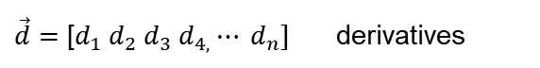

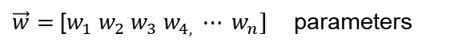
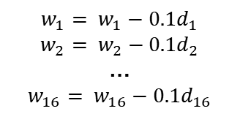

Gradient descent with vectorization
$\vec{w}=$ [$w_{1} w_{2} w_{3} w_{4,} ⋯ w_{n}]$ parameters
$\vec{d}=$ [$d_{1} d_{2} d_{3} d_{4,}⋯ d_{n}]$ derivatives
Compute $w_{j}= w_{j}−0.1d_{j}$ for j=1,…,16
Without vectorization
vectorization
$$w_{1}= w_{1}−0.1d_{1}$$
$$w_{2}= w_{2}−0.1d_{2}$$
…
$$w_{16}= w_{16}−0.1d_{16}$$
$$\vec{w}=\vec{w}−0.1\vec{d}$$
for loop문 -> 16번 반복
w
0.1*d
동일한 위치의 원소마다 계산

Slide 14

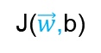

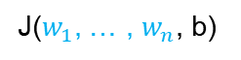
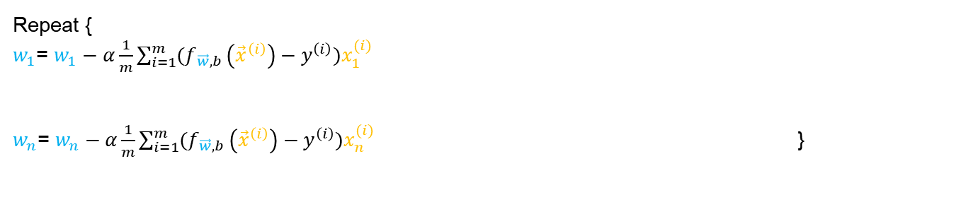
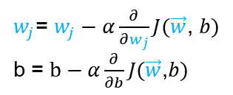
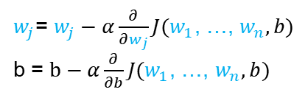
Gradient descent for multiple linear regression
Without vectorization
vectorization
Cost function
Gradient descent
J($w_{1}$, … , $w_{n}$, b)
J($\vec{w}$,b)
$w_{j}$= $w_{j}−α\frac{∂}{∂w_{j}}J(w_{1}$, …, $w_{n}, b)$
b = $b−α\frac{∂}{∂b}J(w_{1}$, …, $w_{n}, b)$
$w_{j}$= $w_{j}−α\frac{∂}{∂w_{j}}J(\vec{w}\text{, }b)$
b = $b−α\frac{∂}{∂b}J(\vec{w}\text{,}b)$
Gradient descent with n features
Repeat {
$w_{1}$= $w_{1}−α\frac{1}{m}\sum_{i=1}^{m}{(f_{\vec{w},b }\left({\vec{x}}^{\left(i\right)}\right)−y^{\left(i\right)})x_{1}^{(i)}}$
$w_{n}$= $w_{n}−α\frac{1}{m}\sum_{i=1}^{m}{(f_{\vec{w},b }\left({\vec{x}}^{\left(i\right)}\right)−y^{\left(i\right)})x_{n}^{(i)}}$ }
$$\frac{∂}{∂w_{j}}J(\vec{w}\text{, }b)$$
$b$= $b−α\frac{1}{m}\sum_{i=1}^{m}{(f_{\vec{w},b }\left({\vec{x}}^{\left(i\right)}\right)−y^{\left(i\right)}) }$

Slide 15
An alternative to gradient descent
Normal equation : 경사면 하강이 아니라 한 번에 최저점을 찾는 방법
Only for linear regression
Solve for w, b without iterations
Disadvantages
Doesn’t generalize to other learning algorithms
Slow when number of features is large
Normal equation method may be used in machine learning libraries that implement linear regression
Gradient descent is the recommended method for finding parameters w,b

Slide 16
감사합니다.

